Slide 1
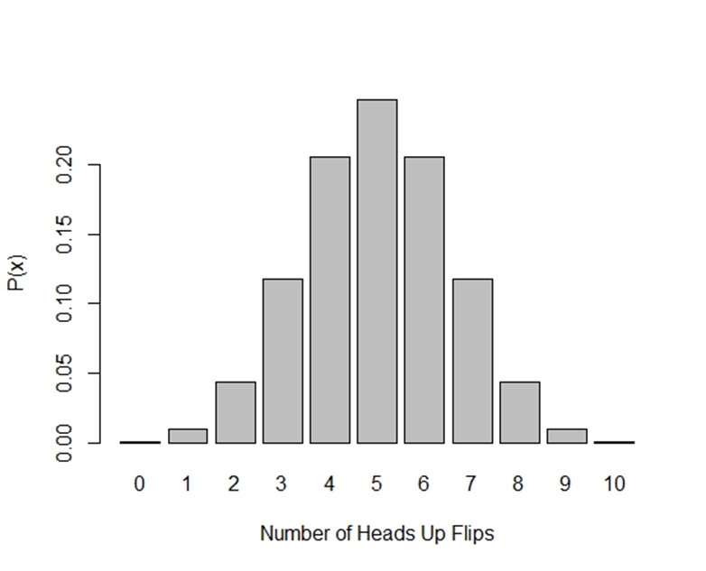
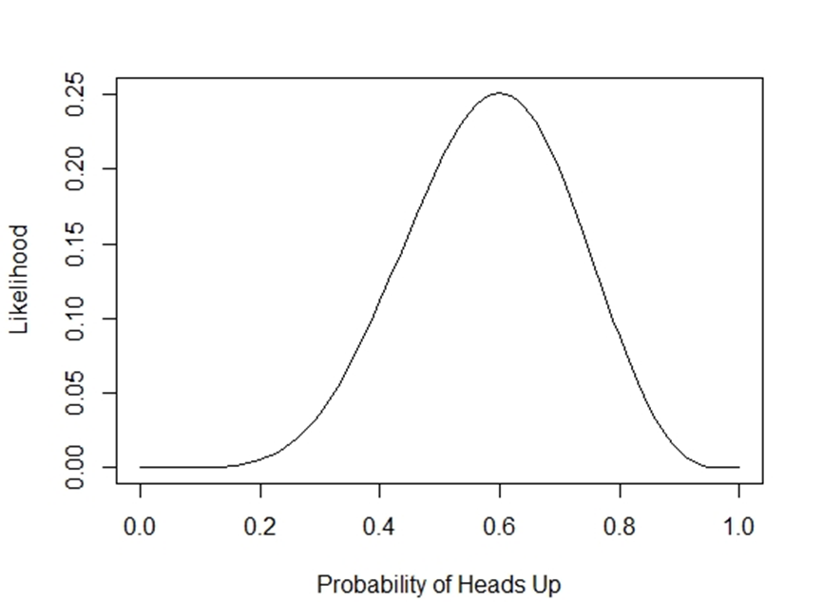

Slide 2
Experiment 1
Comparison Method | Drift Rate (γ) | Response Threshold (α) | Shift (ϴ)
Correlation | 0.36 | 0.16 | 0.30
RMSD | 2.42 | 3.47 | 0.24
Mean Bias | 0.58(0.58) | 0.96(0.98) | -0.05(0.06)

Slide 3
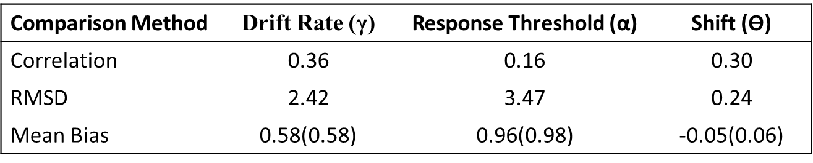
Experiment 1

Slide 4
Experiment 2
Comparison Method | Drift Rate (γ) | Response Threshold (α) | Shift (ϴ)
Correlation | 0.73 | 0.53 | 0.80
RMSD | 0.66 | 0.30 | 0.04
Mean Bias | 0.06(0.15) | 0.03(0.07) | 0.00(0.01)

Slide 5
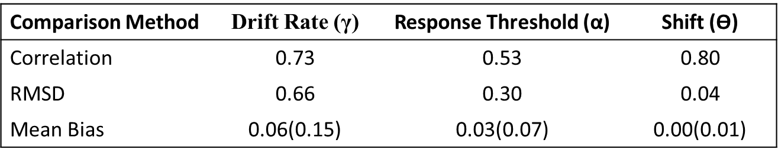
Exp 2

Slide 6
Experiment 3
Comparison Method | Drift Rate (γ) | Response Threshold (α) | Shift (ϴ)
Correlation | 0.94 | 0.87 | 0.97
RMSD | 0.24 | 0.09 | 0.01
Mean Bias | 0.01(0.05) | 0.00(0.02) | 0.00(0.00)

Slide 7
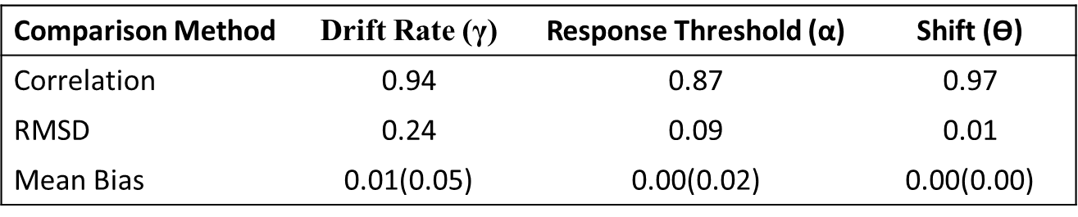
Exp 3

Slide 8
Experiment 4
Comparison Method | Drift Rate (γ) | Response Threshold (α) | Shift (ϴ)
Correlation | 0.93 | 0.86 | 0.95
RMSD | 0.23 | 0.09 | 0.01
Mean Bias | 0.02(0.10) | 0.01(0.04) | 0.00(0.01)

Slide 9
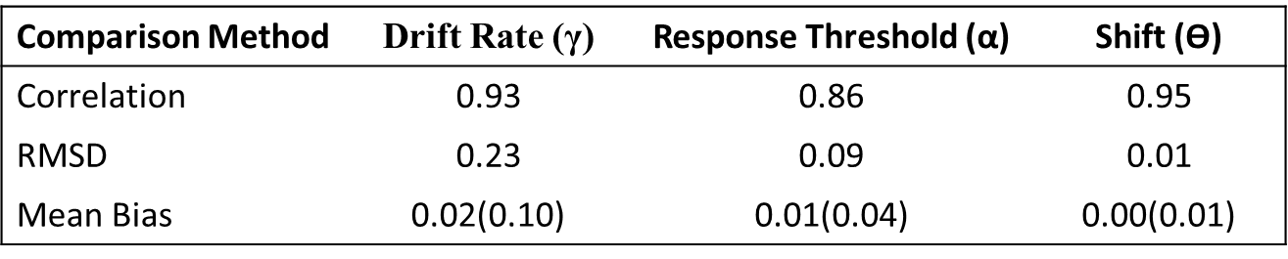
Exp 4

Slide 10
Experiment 5
Comparison Method | Drift Rate (γ) | Response Threshold (α) | Shift (ϴ)
Correlation | 0.32 | 0.12 | 0.21
RMSD | 2.65 | 4.17 | 0.27
Mean Bias | 0.61(0.31) | 0.98(0.48) | -0.05(0.04)

Slide 11
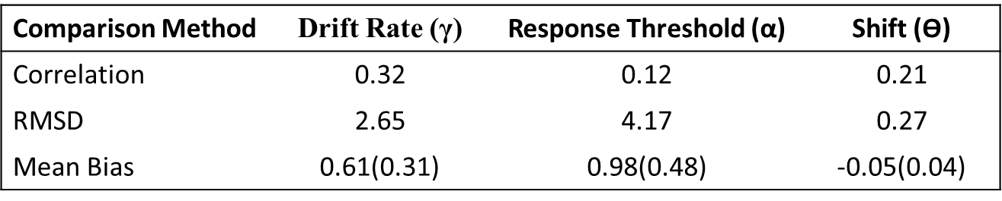
Exp 5

Slide 12
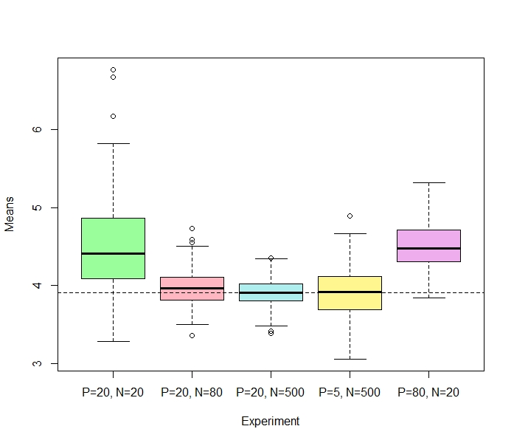
Drift Rate
Experiment | Mean
1 | 4.49 (0.60)
2 | 3.97 (0.23)
3 | 3.91 (0.17)
4 | 3.92 (0.32)
5 | 4.52 (0.31)

Slide 13
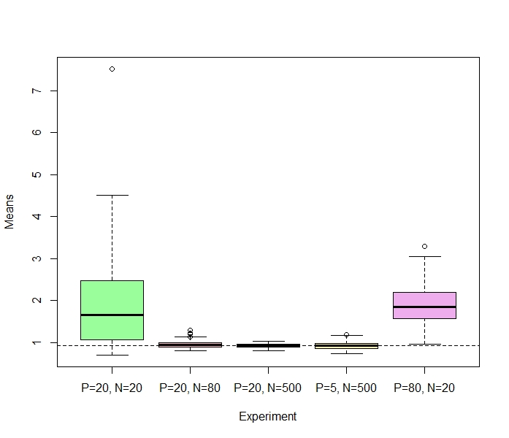
Response Threshold

Slide 14
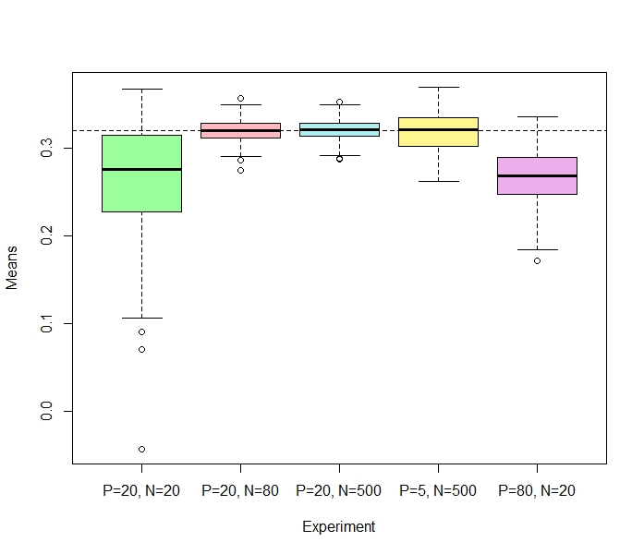
Shift

